Slide 1

Nitin’s Expense Analysis
&
Savings Plan
A Data-Driven Project on Smart Spending

Slide 2
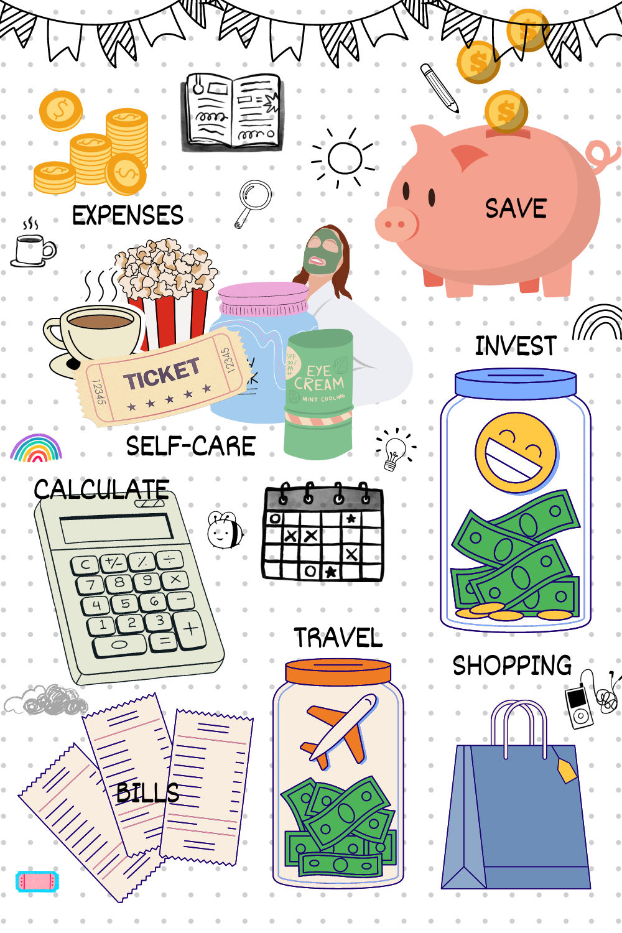
Project Overview
‘In today’s world, financial planning is essential’
Our project focuses on Nitin, a graphic designer who earns ₹15,000/month but struggles to save for his scooter.
By analyzing his monthly and 6-month expenses.
we aim to:
Identify where most of his money is going
Distinguish essential vs. non-essential spending
Recommend practical savings strategies

Slide 3
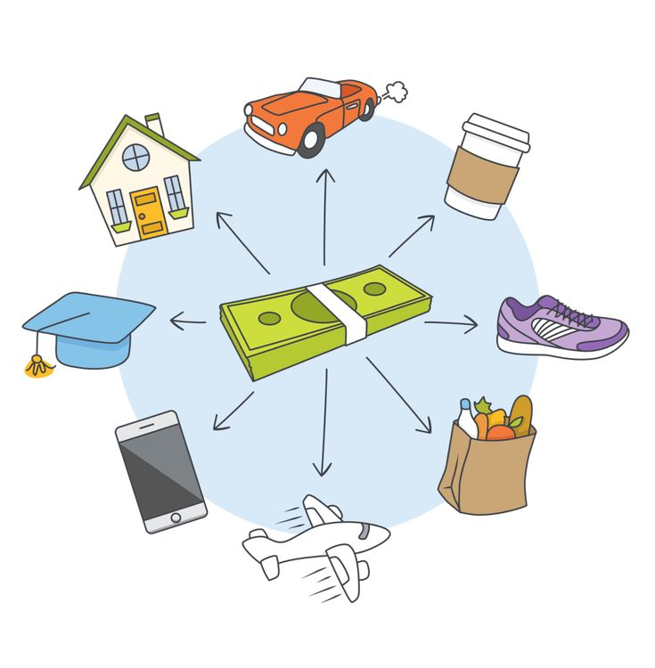

Problem Statement
Nitin has no savings despite a fixed salary.
He spends frequently on non-essential categories like entertainment, dining out, and shopping.
Without expense tracking, he cannot identify where to cut costs.
Using data analysis, we can highlight overspending and guide him to achieve his savings goal.

Slide 4



PROJECT GOALS
Trend Identification & Problem Areas
Find expense peaks & top spending categories.
Highlight non-essential spending habits.
Recommendations
Suggest ways to reduce spending and increase savings for his scooter.
Expense Analysis
Understand June & 6-month spending.

Slide 5
June Expense Snapshot / Chart Slide
Category | Expense (₹) | Type
Grocery | 4,690 | Essential
Shopping | 3,500 | Non-Essential
Ticket & Bills | 2,570 | Essential
Entertainment | 1,000 | Non-Essential
Food | 850 | Non-Essential
Miscellaneous | 500 | Non-Essential
Doctor & Medicine | 450 | Essential
Total | 13,560

Slide 6
6-Month Trend Snapshot / Chart Slide
Month | Essential (₹) | Non-Essential (₹) | Total (₹) | % Non-Essential
January | 8,000 | 5,900 | 13,900 | 42%
February | 9,200 | 6,420 | 15,620 | 41%
March | 7,800 | 5,340 | 13,140 | 41%
April | 8,400 | 6,400 | 14,800 | 43%
May | 7,900 | 5,470 | 13,370 | 41%
June | 7,710 | 5,850 | 13,560 | 43%
Notes:
How you calculated the table
Your table shows:
%Non-Essential=Non-EssentialTotal×100\% \text{Non-Essential} = \frac{\text{Non-Essential}}{\text{Total}} \times 100%Non-Essential=TotalNon-Essential​×100 For January:
%=5,90013,900×100=42.45%≈42%\% = \frac{5,900}{13,900} \times 100 = 42.45\% \approx 42\%%=13,9005,900​×100=42.45%≈42%

Slide 7

Trend Identification
Monthly Spending Peaks:
February → highest spending ₹15,620
April → second highest ₹14,800
Top Categories:
Non-essential spending dominates: Shopping, Entertainment, Dining Out
Patterns Observed:
Non-essential expenses consistently ~41–43% of total monthly spending
Food delivery & movies contribute significantly to overspending
Implication
Without Controlling These Categories, Nitin Cannot Save For His Scooter

Slide 8
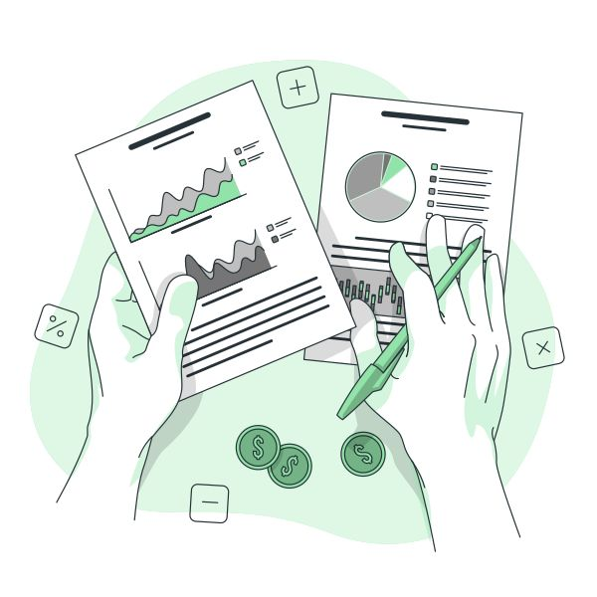

Problem Areas
Where Nitin Overspends
Dining Out & Food Delivery → Frequent & costly
Entertainment (Movies, Shopping) → Large share of monthly expenses
High non-essential spending reduces savings potential
Suggested Picture/Visual:
Icons for food, shopping bag, movie ticket
Optional: Small red warning symbols to highlight overspending

Slide 9

Recommendations
Limit Dining Out & Online Food Orders – Cut down frequency to 1–2 times a month to save a significant amount.
✅ Reduce Entertainment Expenses – Watch movies at home or choose free/low-cost options.
✅ Control Shopping Habits – Fix a monthly budget for shopping and avoid impulse buying.
✅ Track Monthly Expenses – Maintain a simple expense tracker to monitor where money goes.
✅ Set a Savings Goal – Save a fixed amount every month to reach the scooter target within a few months.

Slide 10

Conclusion
Our analysis showed that Nitin’s major expenses go toward non-essential categories like dining out, shopping, and entertainment. By reducing these costs and setting a fixed savings goal each month, he can significantly increase his savings. With disciplined spending and proper planning, Nitin will be able to afford his scooter within a short period. This project proves how simple data analysis can turn everyday expenses into meaningful financial decisions.
💡 Smart spending today ensures financial freedom tomorrow

Slide 11

Documentation
The project was carried out through a structured process:
📊 Data Analysis – Expense details from June and 6 months were studied using Excel.
📈 Visualizations – Pivot tables, bar charts, and pie charts were created to highlight spending patterns.
🤝 Collaboration – Tasks were divided among team members, with equal contributions and brainstorming sessions.
✅ Final Output – Insights and recommendations were consolidated into this presentation.

Slide 12
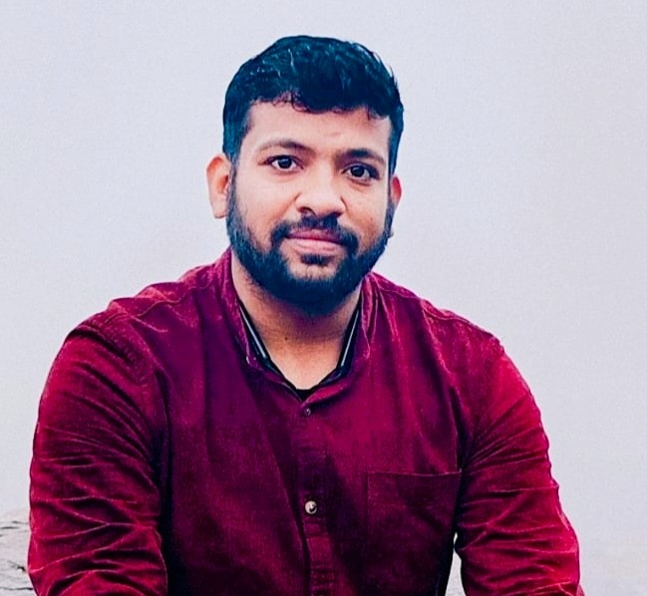
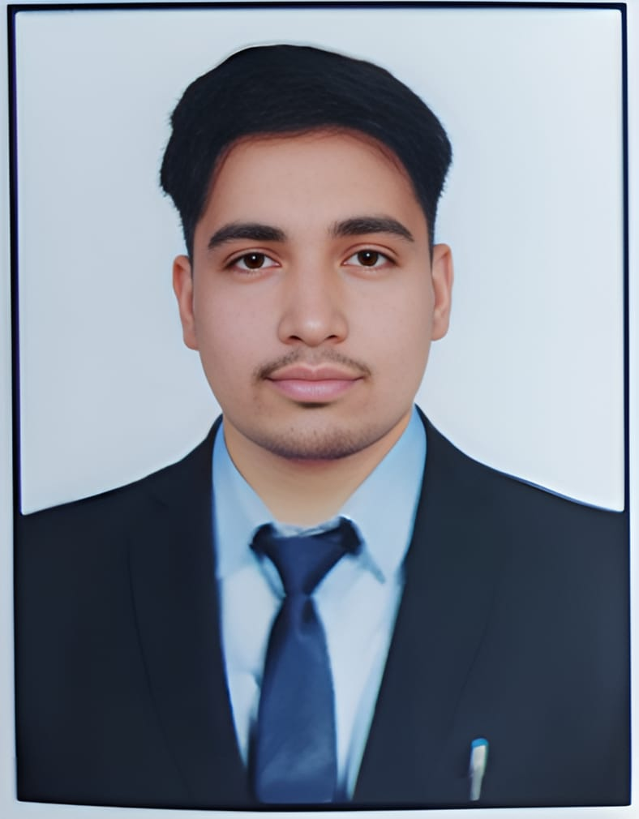


Our Team
We are a passionate and dedicated team that came together to analyze real-life financial data. Using tools like Excel, Pivot Tables, and Charts, we explored spending patterns to solve money management problems. Each member contributed equally by taking up specific responsibilities and working collaboratively. Through teamwork and brainstorming, we turned raw data into meaningful insights and practical solutions.
👤 D.Y. Rao
(Presentation&Recommendations) 📧 raocareerpath@gmail.com
👤 Rehan (Visualization & Charts) 📧 rehan733100@gmail.com
👤 Nadeem
(Data Analysis) 📧nadeemnaduu617@gmail.com
👤 Swaroop Kumar
(Insights & Documentation) 📧kswaroopkumar67@gmail.com

Slide 13

THANK YOU

